Slide 1

Angular lecture 6 Http Client

Slide 2
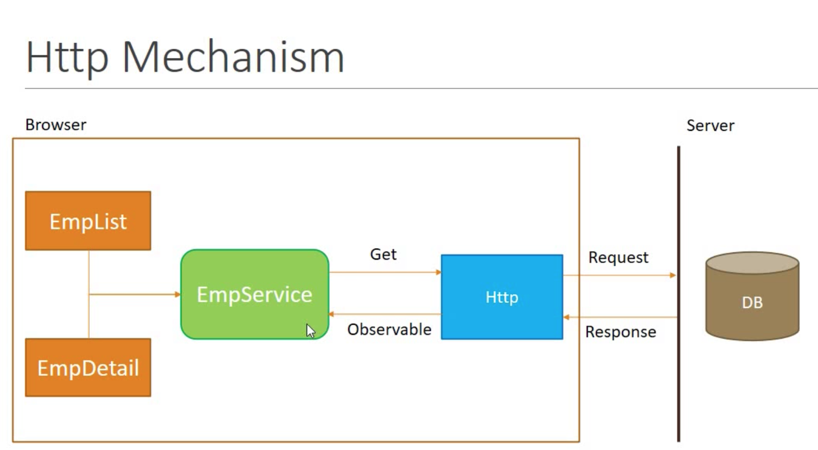
Service

Slide 3
Service
PostService
## create to Create PostService :
ng g i services/post
import { Injectable } from '@angular/core';
import { HttpClient } from '@angular/common/http';
@Injectable({ providedIn: 'root' })
export class PostService {
constructor(private httpclint:HttpClient) { }
getPosts(){ return this.httpclint.get("http://jsonplaceholder.typicode.com/posts");
}
}

Slide 4
Injectable PostService and get data
import { Component, OnInit } from '@angular/core';
import { PostService } from 'src/app/serves/post.service';
@Component({ selector: 'app-http-client',
templateUrl: './http-client.component.html',
styleUrls: ['./http-client.component.css'] })
export class HttpClientComponent implements OnInit {
posts
constructor(private post:PostService) { }
ngOnInit() {
this.post.getPosts().subscribe(
(data)=> this.posts=data
);
}
}
<h1>posts</h1>
<hr>
<details *ngFor="let post of posts">
<summary>
{{post.title}}
</summary>
<p>{{post.body}}</p>
</details>

